Slide 1


Gender-based classification of Sandfly Genitalia using Attention based CNN and Pre-trained models
Authors
Md Ripon Al Mamun, Maksura Binte Rabbani Nuha, Mariya Rahman Momo, Md Tahsin, Akil Rahman Efad, M. Saddam Hossain Khan, Mohammad Rifat Ahmmad Rashid, Raihan Ul Islam, Rashedul Amin Tuhin, Mohammad Shahadat Hossain
1

Slide 2
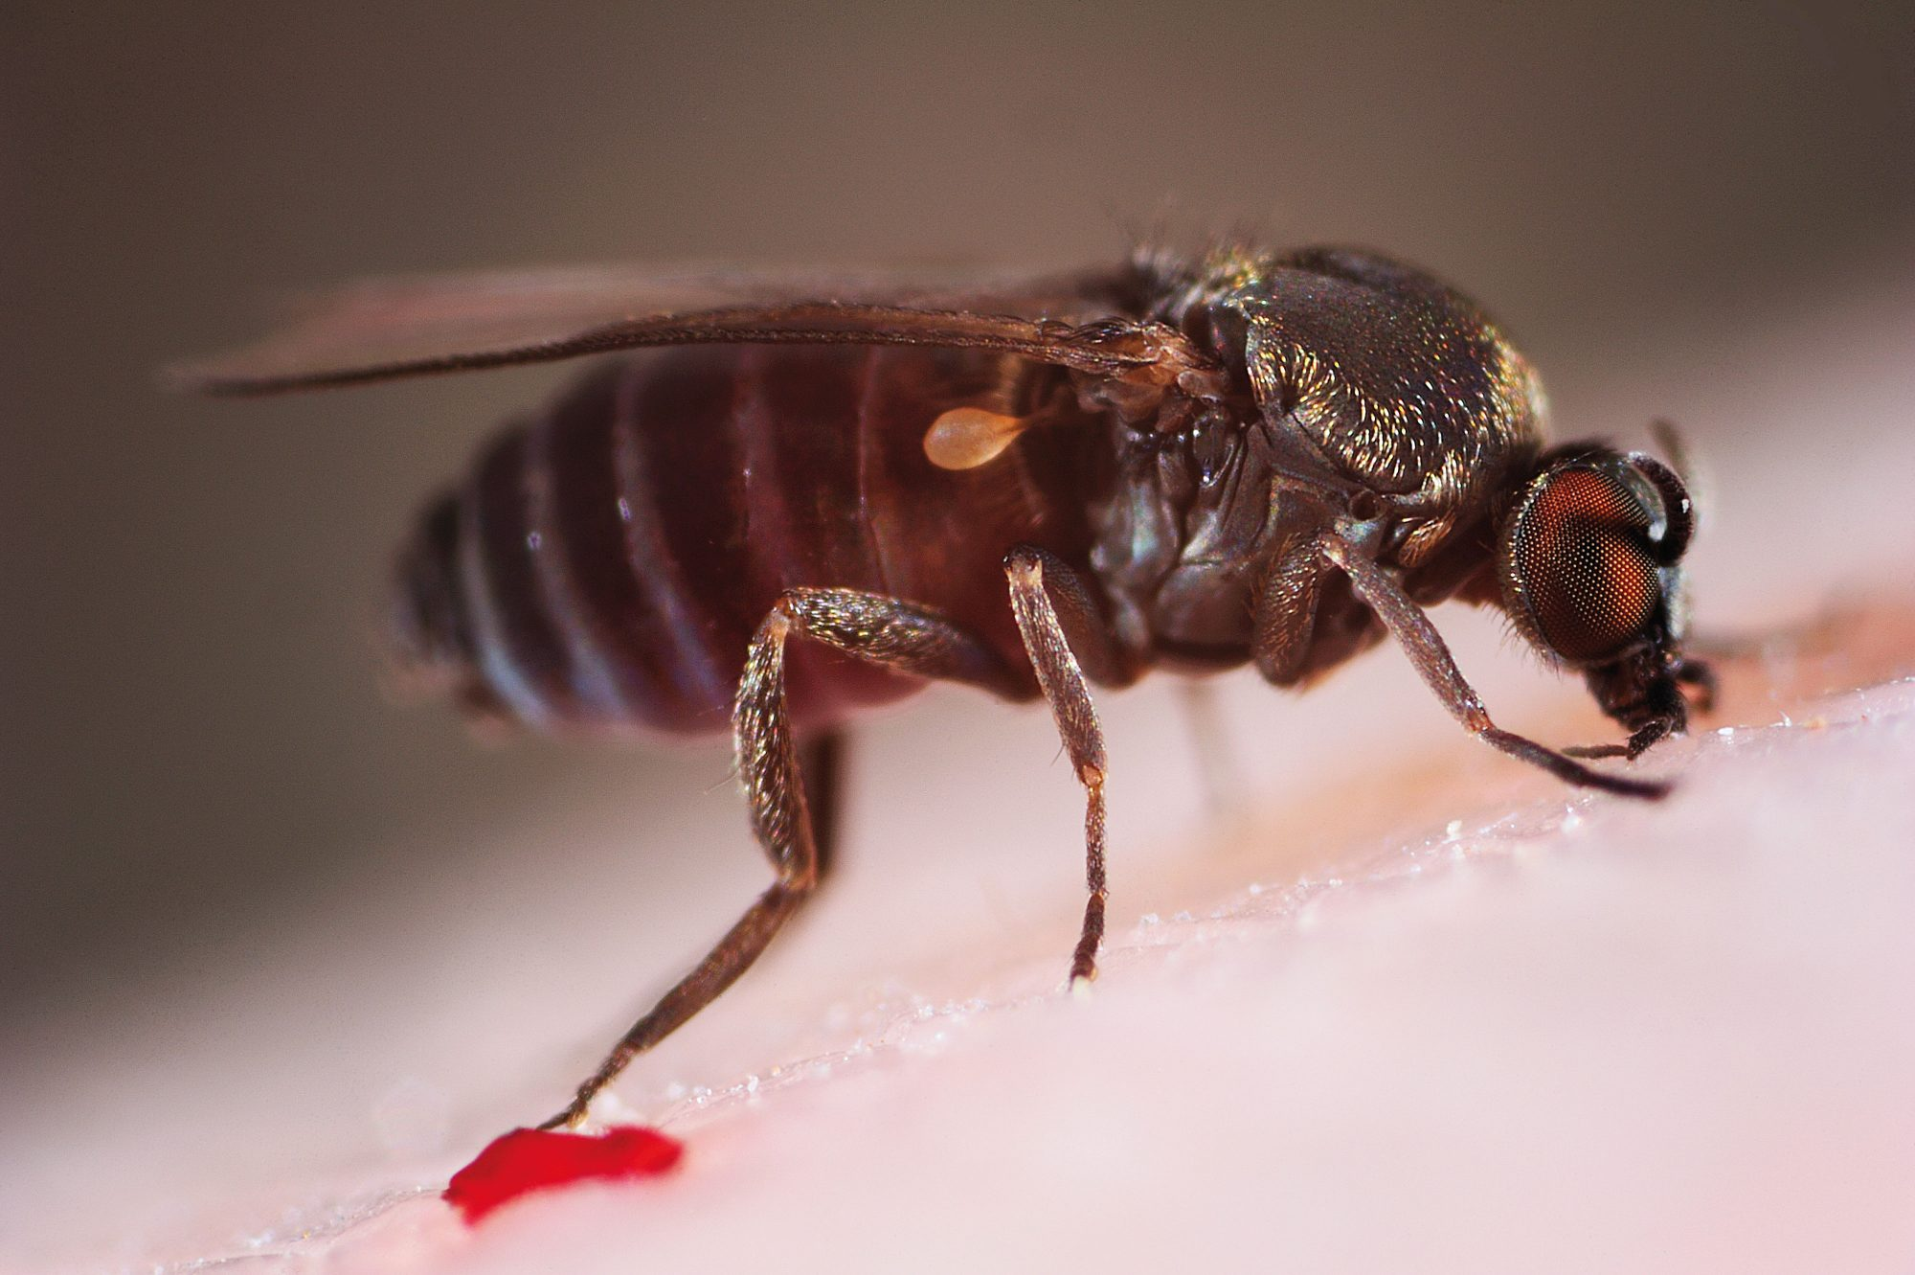

Overview
Introduction
Dataset Information
Motivation
Training Parameters
Literature Review
Model Architecture & Results
Methodology
Conclusion & Future Works
2

Slide 3
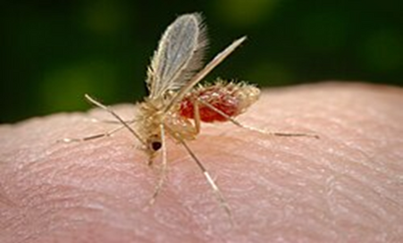
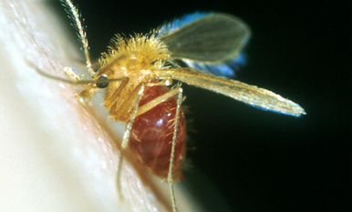
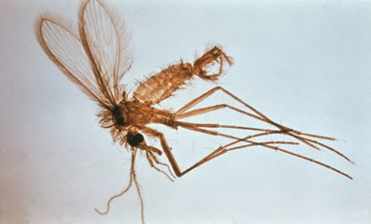
INTRODUCTION
Sandflies spread diseases like leishmaniasis, primarily through females.
Traditional identification relies on microscopic examination of genitalia, which is slow and requires experts.
This study explores an AI-driven solution for faster, more accurate species and gender classification using deep learning.
3

Slide 4






MOTIVATION
Manual identification of sandflies is slow, subjective, and requires experts.
Deep learning with attention mechanisms improves accuracy and interpretability.
Real-time, scalable AI system for field surveillance and vector control.
️
Traditional Limitations
Explainability Integration
Practical Impact
Disease Burden
Dataset Preparation
Model Performance
Vector-borne diseases like leishmaniasis affect millions annually.
Images of sandfly genitalia (Ph. papatasi, Ph. alexandri, Ph. sergenti) were used for training.
Custom CNN achieved 96% accuracy.
4

Slide 5
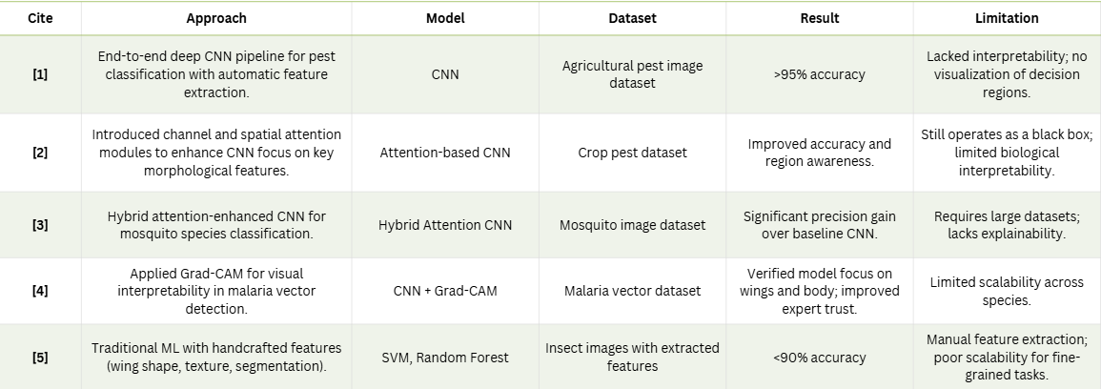
LITERATURE REVIEW
5

Slide 6
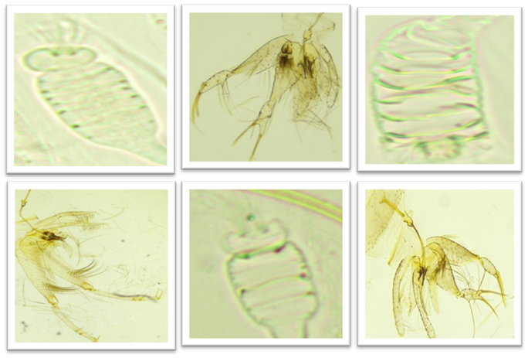
DATASET INFORMATIONS
Source: Mendeley dataset of sandfly genitalia and pharyngeal images.
Species: Ph. papatasi, Ph. alexandri, Ph. sergenti.
Classes: 6 genitalia classes
Data Augmentation:
Image Resizing: 256x256
Fig. 03: Obtained Dataset Images
7

Slide 7
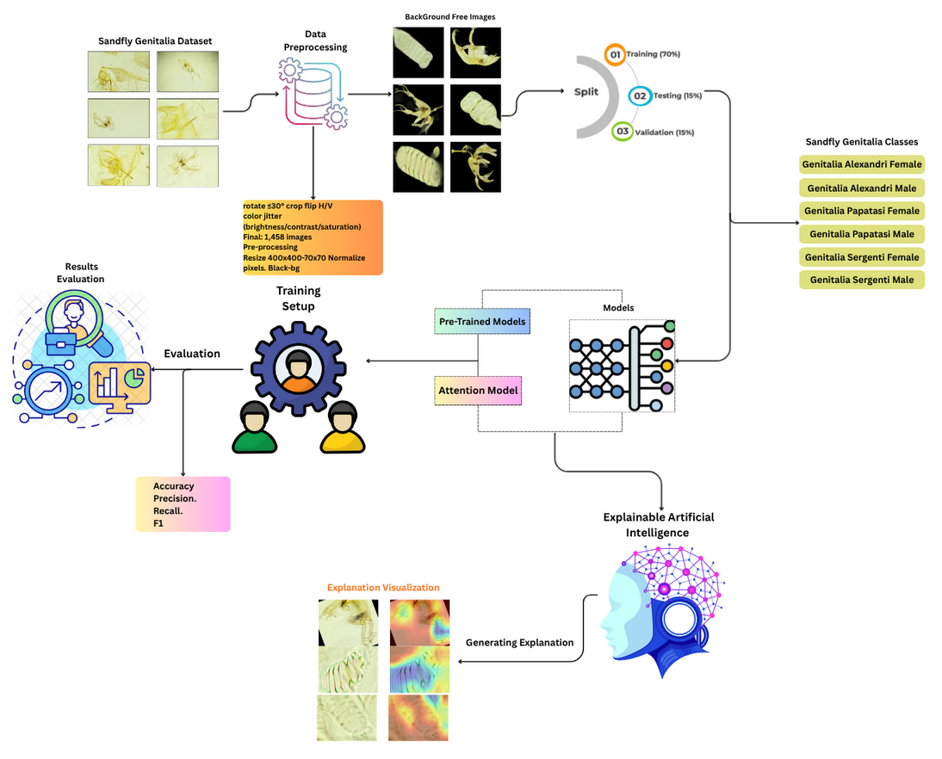
METHODOLOGY
Fig. 02: Overall Pipeline
6

Slide 8
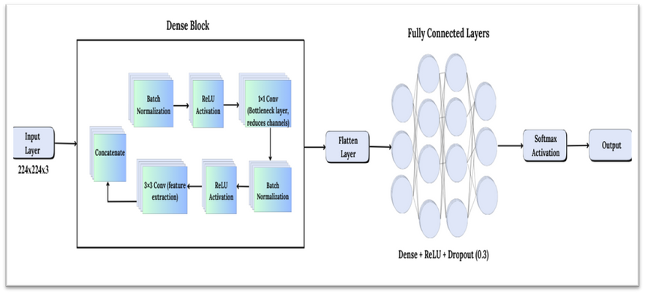
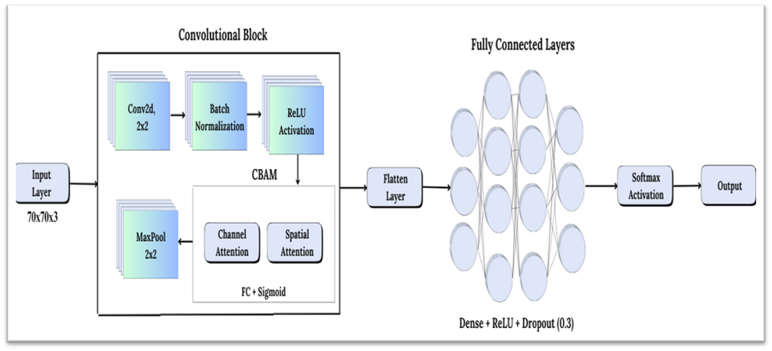
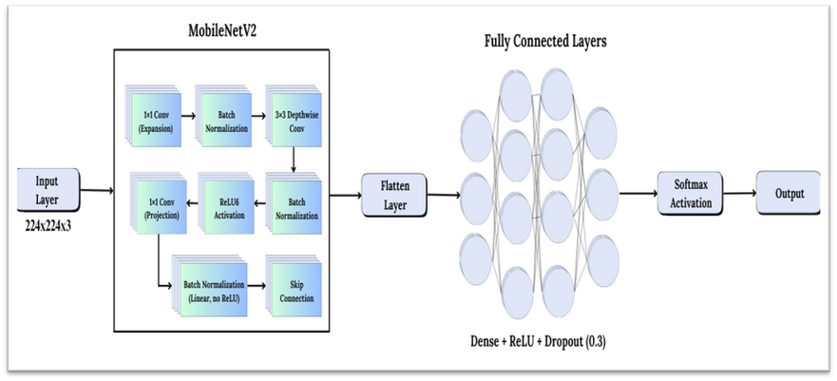
APPLIED MODEL FRAMEWORK
The proposed framework uses a Custom CNN with CBAM for enhanced feature extraction and focus on key morphological details. DenseNet201 and MobileNetV2 were used for comparison. CBAM refines channel and spatial attention, improving accuracy and interpretability in sandfly genitalia classification.
Figure 06: DenseNet201 Architecture
Figure 04: Custom CNN architecture with CBAM integration
Figure 05: MobileNetV2 Architecture
8

Slide 9
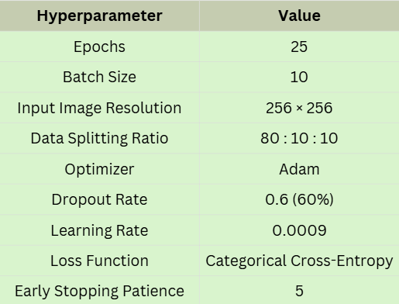
EXPERIMENTAL SETUP TABLES
This table summarizes the key hyperparameters used in our deep learning experiment. The model was trained for 25 epochs with a batch size of 10 on 256×256 images, using an 80:10:10 train-validation-test split. Adam optimizer (lr=0.0009) with 60% dropout and early stopping (patience=5) was applied, using categorical cross-entropy as the loss function.
Table 01: Experimental Setup
9

Slide 10
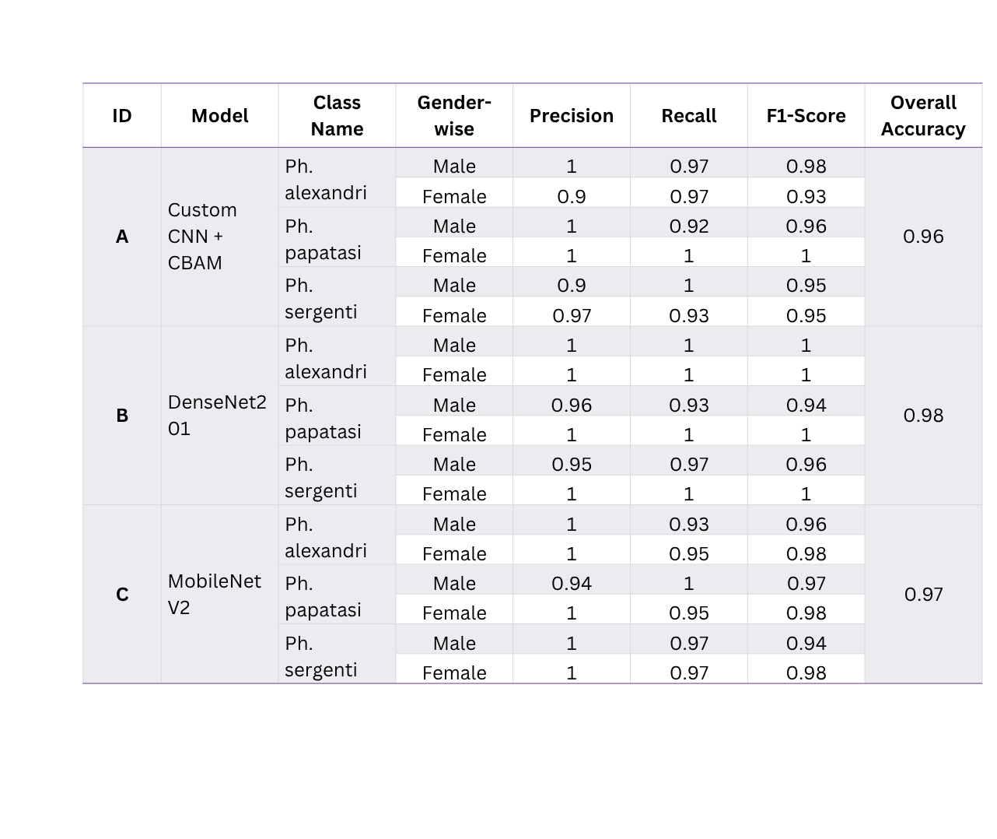
RESULT ANALYSIS
This table shows gender-wise classification for Custom CNN + CBAM, DenseNet201, and MobileNetV2 across three Phlebotomus species. DenseNet201 achieved the highest accuracy (98%), Custom CNN + CBAM excelled for Ph. sergenti, and MobileNetV2 balanced performance with fewer parameters. All models reliably differentiated species and gender with high precision and recall.
11

Slide 11
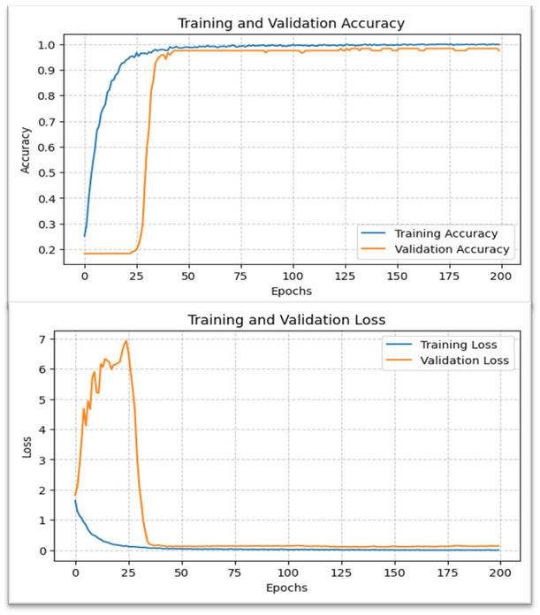
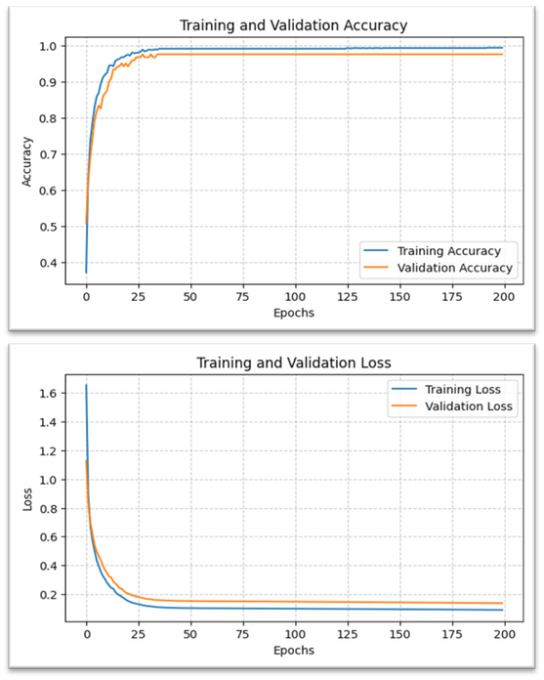
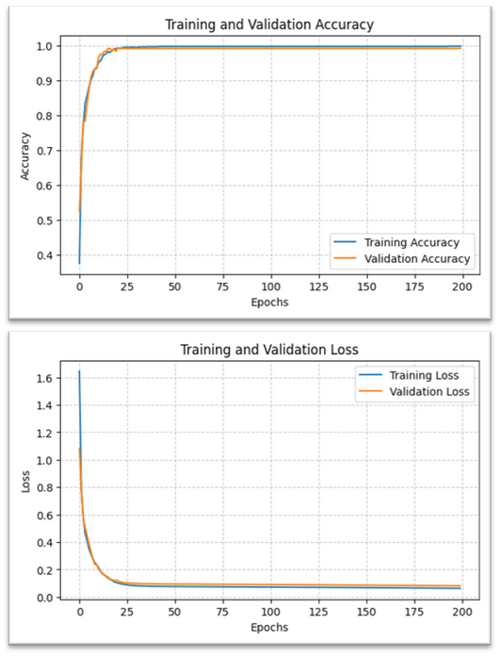
RESULT ANALYSIS
(A)
(B)
(C)
Fig 06: Training & Validation Accuracy (Top) & Loss(Bottom) Curves (A) Custom CNN with CBAM, (B) MobileNETV2 (C) DenseNET201
10

Slide 12
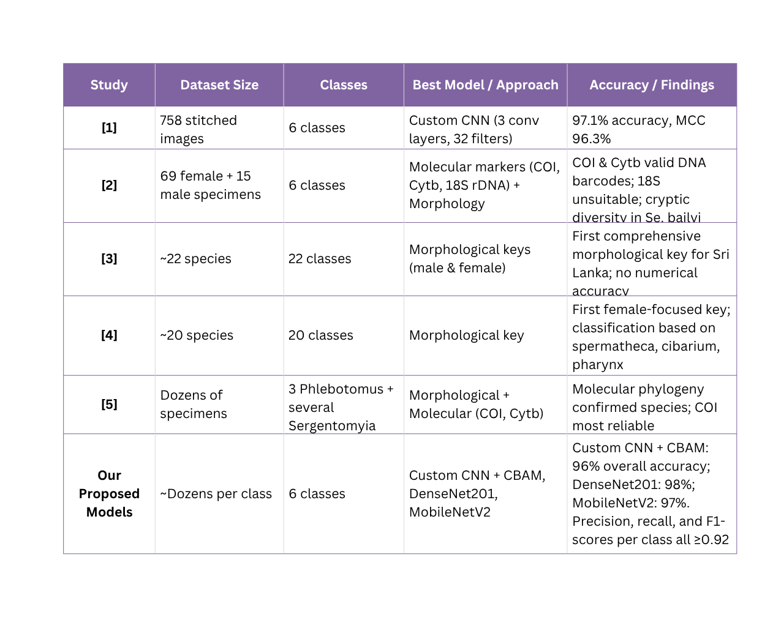
DISCUSSION
Previous methods were accurate but slow and non-automated. While prior deep learning models achieved 97.1% accuracy, they lacked gender differentiation and attention mechanisms. Our models; DenseNet201 (98%), MobileNetV2 (97%), and Custom CNN + CBAM (96%) outperform previous work, offering gender classification with F1-scores >0.93.
12

Slide 13
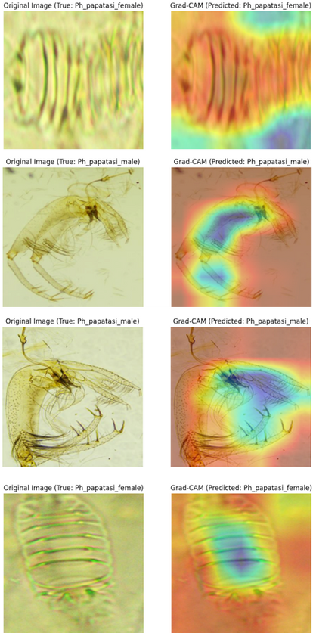
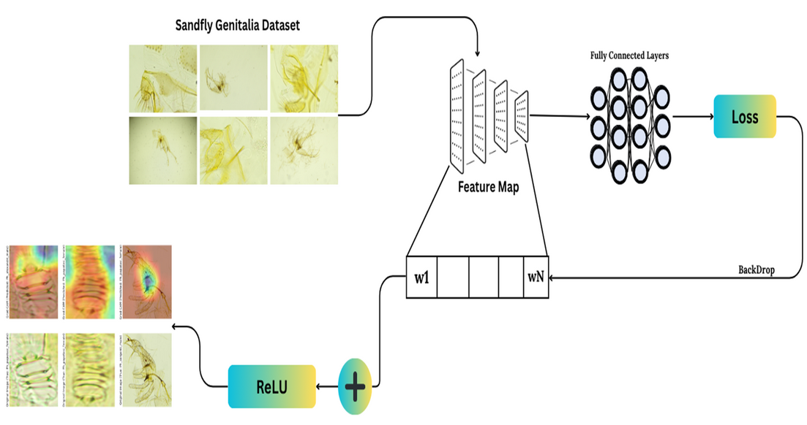
EXPLAINABLE AI (XAI)
XAI makes models transparent and interpretable. In our study, Grad-CAM visualizes key regions in sandfly genitalia images, showing which features distinguish male from female, ensuring biologically meaningful predictions.
Fig. 10: Explainable AI(XAI) Architecture
Fig. 11: Different Explainable AI(XAI) Example
13

Slide 14
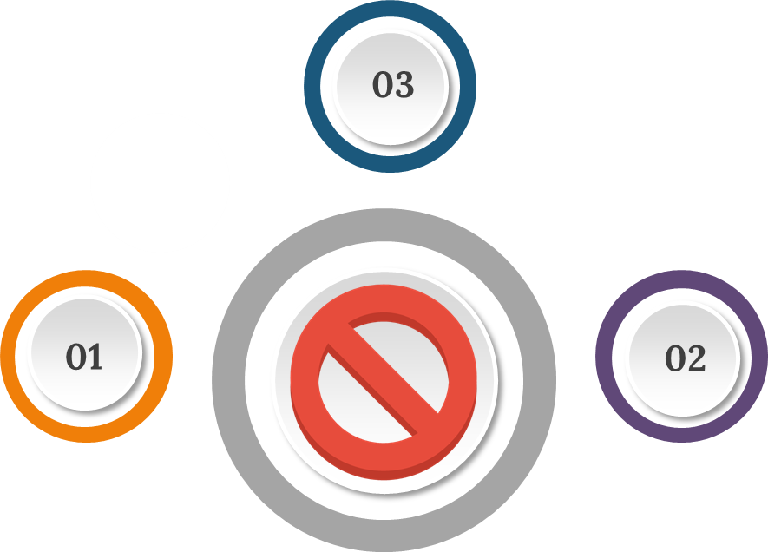
Limitations
Controlled Environment Uniform lighting and background reduce real-world robustness.
Limited Dataset
Restricted number of lab-captured images limits generalization to field conditions.
Gender Imbalance
Slight unevenness between male and female samples affects precision.
14

Slide 15
CONCLUSION
This study presents a deep learning framework for sandfly classification using CNNs with CBAM. Models achieved high accuracy: Custom CNN + CBAM (96%), DenseNet201 (98%), MobileNetV2 (97%), with attention mechanisms providing interpretable visualizations for automated vector detection.
High Accuracy: DenseNet201 (98%), MobileNetV2 (97%), Custom CNN + CBAM (96%).
Explainability: Grad-CAM visualizations provide transparent, biologically meaningful predictions.
Real-Time Deployment: Lightweight models for fast, scalable identification.
Impact: Reliable tool for vector control and disease monitoring.
14

Slide 16

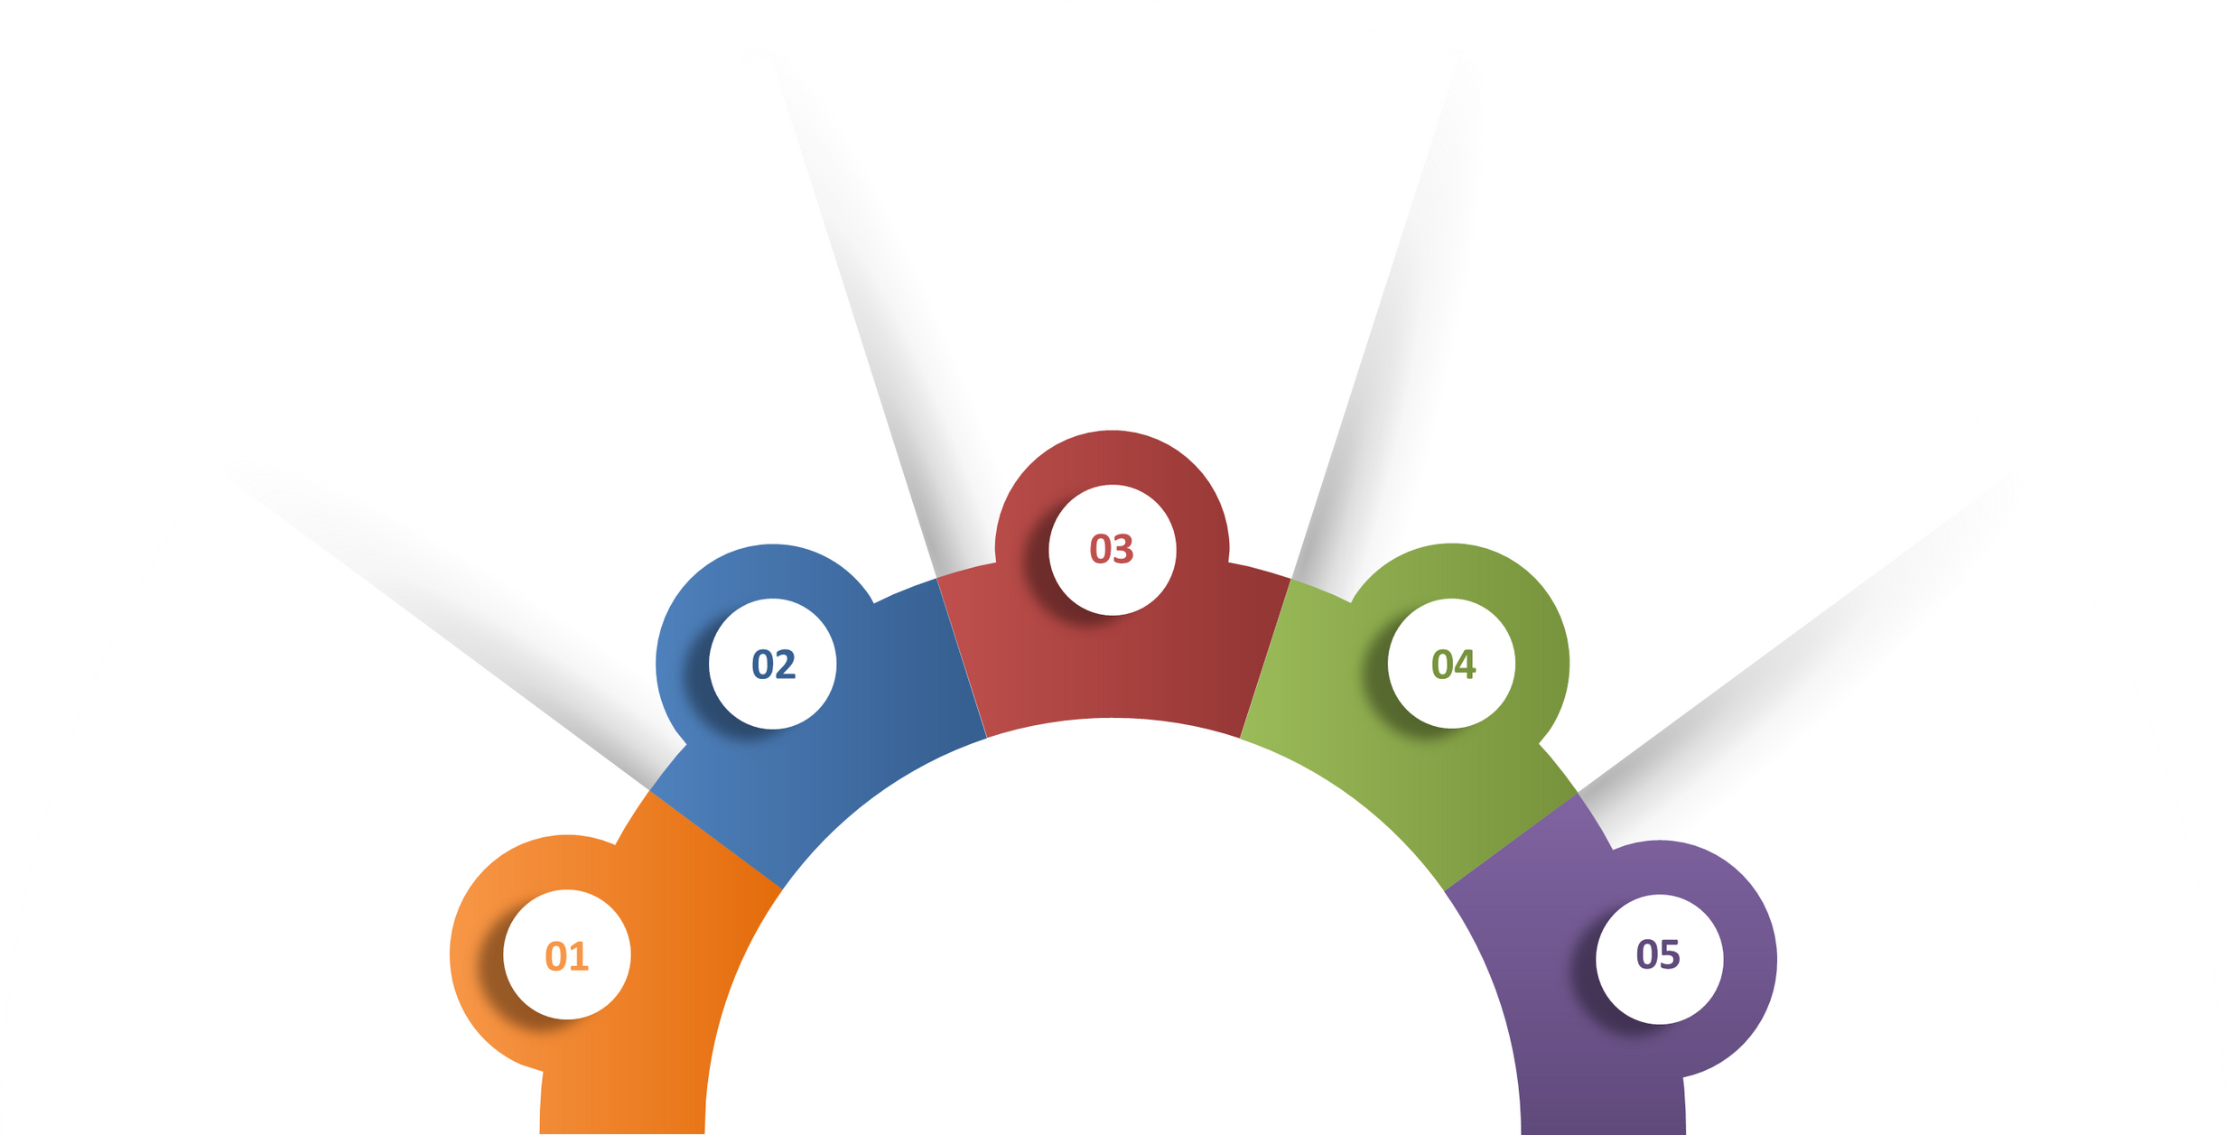




FUTURE WORK
ROI Automation:
Use instance segmentation to detect regions of interest automatically.
Advanced Learning: Apply data augmentation, domain adaptation, and multi-modal fusion
Real-World Validation:
Test models on real images and develop real-time identification tools.
Dataset Expansion:
Include field-collected images and more species for improved robustness.
FUTURE WORK
Integration:
Combine molecular data with visual features for enhanced identification.
15

Slide 17
REFERENCES
[1] L. Zhang, Y. Li, and P. Wang, “Automatic insect identification based on handcrafted features and classical machine learning classifiers,” Applied Entomology and Zoology, vol. 56, no. 2, pp. 123–132, 2021.
[2] A. Kumar and S. Singh, “Hybrid attention-enhanced convolutional network for mosquito species classification,” Ecological Informatics, vol. 69, pp. 101–109, 2023.
[3] J. Wang, F. Liu, and R. Zhao, “Deep convolutional neural network for agricultural pest classification,” Computers and Electronics in Agriculture, vol. 175, pp. 105–112, 2020.
[4] T. Nguyen, Q. Pham, and D. Vo, “End-to-end insect pest recognition using deep convolutional networks,” Expert Systems with Applications, vol. 185, pp. 115–125, 2021.
[5] S. Li, Y. Chen, and X. Zhou, “Attention-based convolutional neural network for crop pest image classification,” Biosystems Engineering, vol. 207, pp. 16–27, 2022.
16

Slide 18

Thank You!
16

